Slide 1
Artificial Intelligence
Goal Stack Planning
ADF

Slide 2
Planning problem
Artificial Intelligence

Slide 3
Real World Problem
Traditional search methods does not fit to a large, real world problem
We Need
Problem decomposition
General knowledge
General heuristic
Artificial Intelligence

Slide 4
Elevator Control System
Traditional Elevator Control
One direction (up/down) until no further destination in the same direction is requested
Imagine the building has hundreds level
Or the building is applying VIP-level passenger
Artificial Intelligence

Slide 5
Elevator Control System
Now the elevator must be smart
Not learning
Not reasoning
Not just searching
But PLANNING
Artificial Intelligence

Slide 6
Planning
Action or process of making plans for something
In AI, planning is
A method of problem solving by breaking the problem into smaller sub-problems,
completing sub-problems one by one, then
combining the solutions of the sub-problems into a complete solution
while keeping in mind and handling the interactions contained on these sub-problems
Artificial Intelligence

Slide 7
Planning problem
Find a sequence of actions that achieves a given goal when executed from a given initial world state.
That is, given
a set of operator descriptions (defining the possible primitive actions by the agent),
an initial state description, and
a goal state description or predicate
Artificial Intelligence

Slide 8
Planning problem
compute a plan, which is
a sequence of operator instances, such that executing them in the initial state will change the world to a state satisfying the goal-state description.
Goals are usually specified as a conjunction of goals to be achieved
Artificial Intelligence

Slide 9
Planning problem
States, goals, and actions are decomposed into sets of sentences (usually in first-order logic)
Sub-goals can be planned independently, reducing the complexity of the planning problem
Artificial Intelligence

Slide 10
Typical assumptions: Action
Atomic time: Each action is indivisible
No concurrent actions are allowed (though actions do not need to be ordered with respect to each other in the plan)
Deterministic actions: The result of actions are completely determined—there is no uncertainty in their effects
Artificial Intelligence

Slide 11
Typical assumptions: Agent
Agent is the sole cause of change in the world
Agent is omniscient:
Has complete knowledge of the state of the world
Closed World Assumption:
Everything known to be true in the world is included in the state description.
Anything not listed is false.
Artificial Intelligence

Slide 12
STRIPS and GSP
Artificial Intelligence

Slide 13
STRIPS
Stanford Research Institute Problem Solver
an automated planner developed by Richard Fikes and Nils Nilsson in 1971 at SRI International
States and goal –sentences in FOL.
Artificial Intelligence

Slide 14
STRIPS Operators
Operator name
Preconditions –a sentence describing the conditions that must occur so that the operator can be executed.
Effect –a sentence describing how the world has change as a result of executing the operator. Has 2 parts:
Add-list
Delete-list
Artificial Intelligence

Slide 15
Goal Stack Planning
The reasoning strategy used by STRIPS
Makes use of a goal stack GS that contains both subgoals and actions that have been proposed to satisfy those subgoals.
It also relies on a database DB that describes the current situation, and a set of actions described by precondition, add and delete lists.
Artificial Intelligence

Slide 16
GSP Components
Current States
Problem Stack
Operation Set
Solution Queue
Goal State
Artificial Intelligence

Slide 17
Block World
Artificial Intelligence

Slide 18
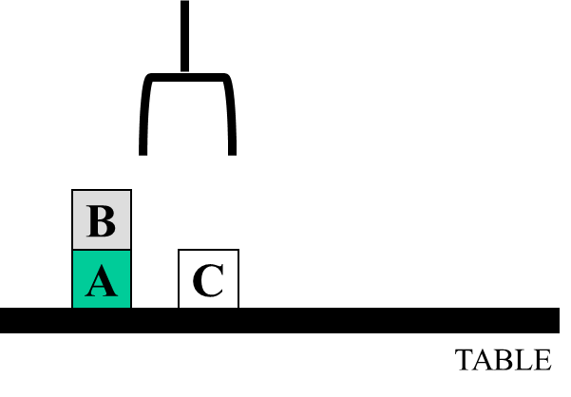
Block World
Another simple simulation environment
The blocks world is a micro-world that consists of a table, a set of blocks and a robot hand.
Artificial Intelligence

Slide 19
Block World Domain Constraints
One block can be put on (above) another block
Any number of blocks can be on the table
The hand can only hold one block
Artificial Intelligence

Slide 20
Block World Representation
Blocks States
ontable(X)
on(X,Y)
clear(X)
Hand States
armempty
holding(X)
Artificial Intelligence

Slide 21
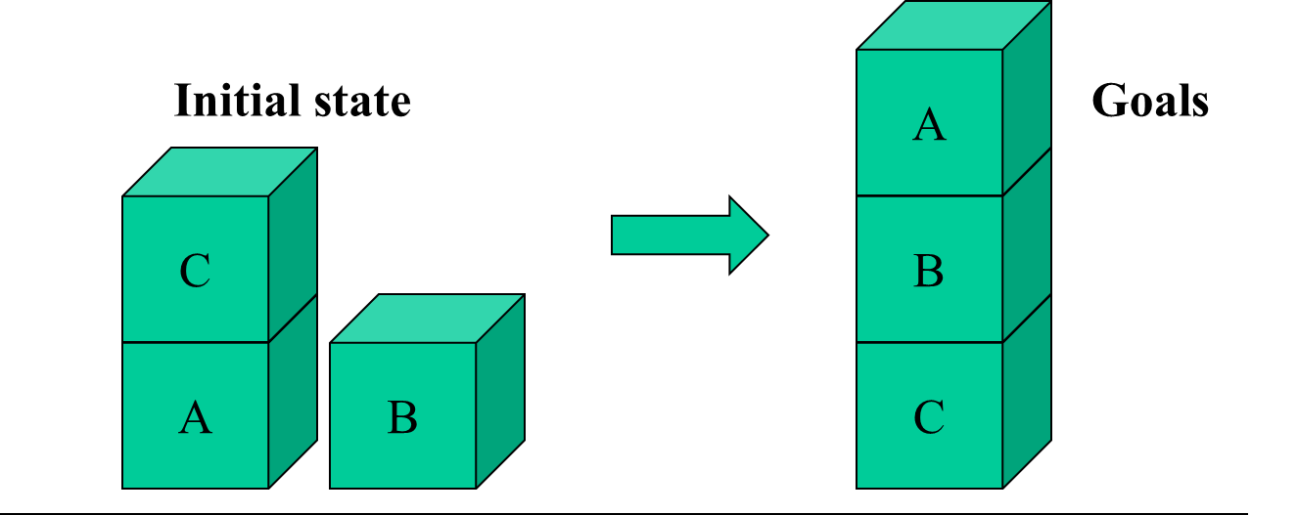
Block World Initial and Goal State
Initial state:
onTable(A)
on(C,A)
onTable(B)
clear(B)
clear(C)
Goals:
onTable(C) on(B,C) on(A,B) clear(A)

Slide 22
Operation Set
Operation Name
Precondition
States that must be present at current state
Add
States to be add to the current state
Delete
State to be removed from current state
Artificial Intelligence

Slide 23
Block World Operations
stack(X,Y):
put block X on block Y
unstack(X,Y):
remove block X from block Y
pickup(X):
pickup block X
putdown(X):
put block X on the table
Artificial Intelligence

Slide 24
STACK(x,y)
P : CLEAR(y) ∧ HOLDING(x)
A : ON(x,y) ∧ ARMEMPTY
D : HOLDING(x) ∧ CLEAR(y)
UNSTACK(x,y)
P : ON(x,y) ∧ CLEAR(x) ∧ ARMEMPTY
A : HOLDING(x) ∧ CLEAR(y)
D : ON(x,y) ∧ ARMEMPTY
PICKUP(x)
P : ONTABLE(x) ∧ CLEAR(x) ∧ ARMEMPTY
A : HOLDING(x)
D : ONTABLE(x) ∧ ARMEMPTY
PUTDOWN(x)
P : HOLDING(x)
A : ONTABLE(x) ∧ ARMEMPTY
D : HOLDING(x)
Artificial Intelligence

Slide 25
Block World Actions
No block on top of ?x
No block on top of ?y nor ?x
?x
?y
?y
?x
…
transformation
…
On table

Slide 26
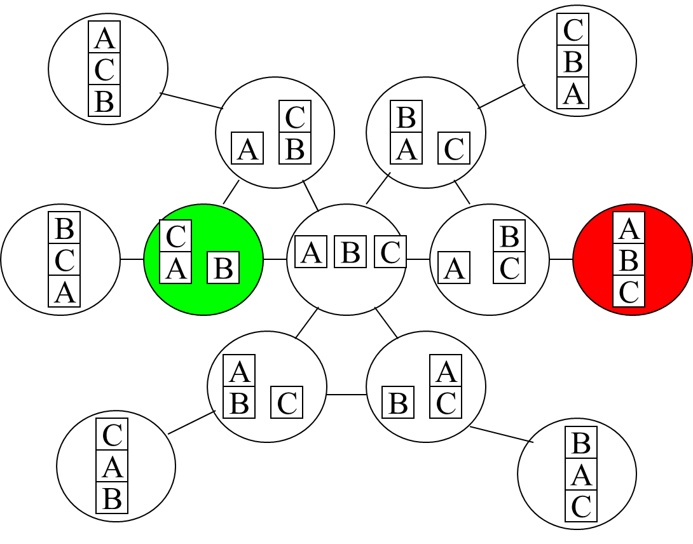
Planning: Search Space

Slide 27
Real Problems
Manufacture: Automotive, Electronics, ...
Elevator Control System
Tour guide
Course Strategy
etc
Artificial Intelligence

Slide 28
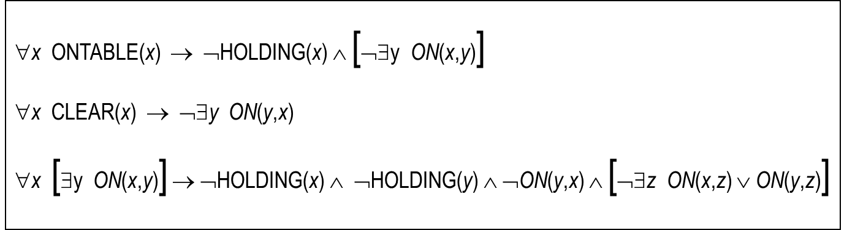
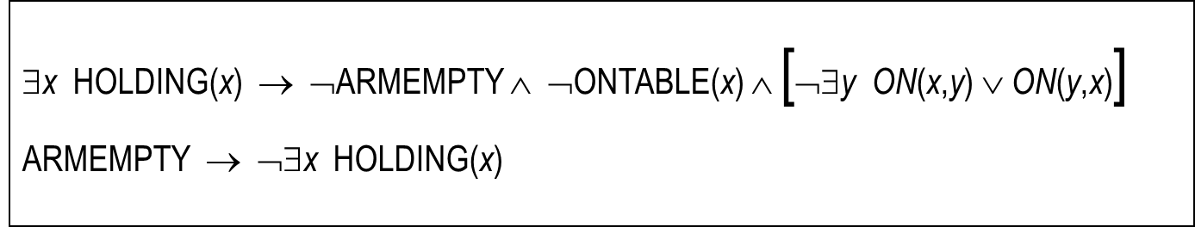
Block World FOL Definition
Artificial Intelligence

Slide 29
GSP Algorithm
Artificial Intelligence

Slide 30
GSP Components
Current States
Problem Stack
Operation Set
Solution Queue
Goal State
Artificial Intelligence

Slide 31
GSP Algorithm
Pick a sub-goal, push into stack
Breakdown its condition in stack
If a condition is already satisfied (already in current state), pop from stack
If a condition is yet to be satisfied, select an operator that will result such condition satisfied,
push operator and its precondition into stack
Artificial Intelligence

Slide 32
GSP Algorithm
If an operator in stack is satisfied (all condition cleared),
pop from stack, add to solution queue
Update current state
Repeat until
stack is empty or
all goal state already in current state
Artificial Intelligence

Slide 33
Block World Example
Artificial Intelligence

Slide 34
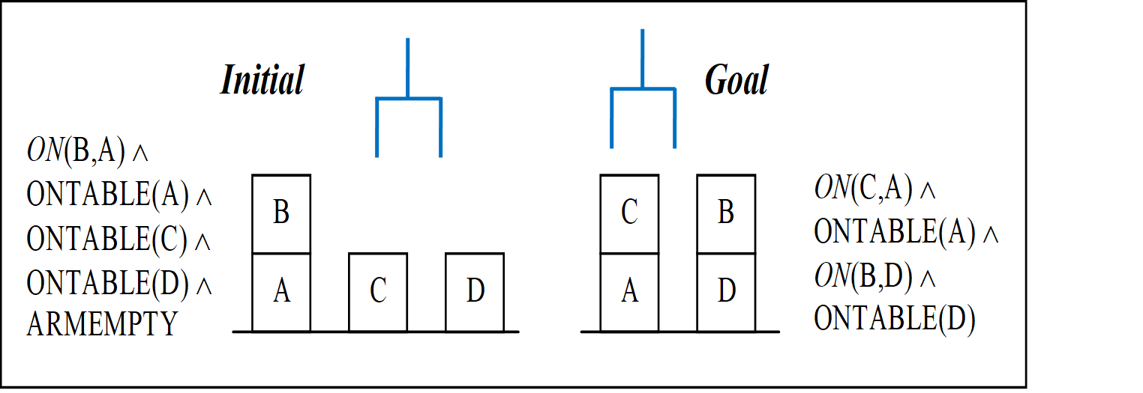
Problem Example
Artificial Intelligence

Slide 35
GSP Example
We have
Goal stack
Current state
Solution queue
Goal stack
Current State
Solution Queue
Artificial Intelligence

Slide 36
GSP Example
First, put all Initial State to Current State
And push all Goal State to Goal Stack
On(B,A) ∧ OnTable(A) ∧ OnTable(C) ∧ OnTable(D) ∧ ArmEmpty ∧ Clear(B) ∧ Clear(C) ∧ Clear(D)
OnTable(A)
OnTable(D)
On(C,A)
On(B,D)
Current
Stack
Solution
Artificial Intelligence

Slide 37
GSP Example
Repeat: read the stack from the top
if a state/condition is already in current, pop from stack
On(B,A) ∧ OnTable(A) ∧ OnTable(C) ∧ OnTable(D) ∧ ArmEmpty ∧ Clear(B) ∧ Clear(C) ∧ Clear(D)
OnTable(A)
OnTable(D)
On(C,A)
On(B,D)
Current
Stack
Solution
Artificial Intelligence

Slide 38
GSP Example
If a state is not yet in current, select an operator that will satisfy such state
STACK(x,y)
P : CLEAR(y) ∧ HOLDING(x)
A : ON(x,y) ∧ ARMEMPTY
D : HOLDING(x) ∧ CLEAR(y)
UNSTACK(x,y)
P : ON(x,y) ∧ CLEAR(x) ∧ ARMEMPTY
A : HOLDING(x) ∧ CLEAR(y)
D : ON(x,y) ∧ ARMEMPTY
PICKUP(x)
P : ONTABLE(x) ∧ CLEAR(x) ∧ ARMEMPTY
A : HOLDING(x)
D : ONTABLE(x) ∧ ARMEMPTY
PUTDOWN(x)
P : HOLDING(x)
A : ONTABLE(x) ∧ ARMEMPTY
D : HOLDING(x)
On(B,A) ∧ OnTable(A) ∧ OnTable(C) ∧ OnTable(D) ∧ ArmEmpty ∧ Clear(B) ∧ Clear(C) ∧ Clear(D)
On(C,A)
On(B,D)
Current
Stack
Solution
Artificial Intelligence

Slide 39
GSP Example
If a state is not yet in current, select an operator that will satisfy such state
STACK(x,y)
P : CLEAR(y) ∧ HOLDING(x)
A : ON(x,y) ∧ ARMEMPTY
D : HOLDING(x) ∧ CLEAR(y)
UNSTACK(x,y)
P : ON(x,y) ∧ CLEAR(x) ∧ ARMEMPTY
A : HOLDING(x) ∧ CLEAR(y)
D : ON(x,y) ∧ ARMEMPTY
PICKUP(x)
P : ONTABLE(x) ∧ CLEAR(x) ∧ ARMEMPTY
A : HOLDING(x)
D : ONTABLE(x) ∧ ARMEMPTY
PUTDOWN(x)
P : HOLDING(x)
A : ONTABLE(x) ∧ ARMEMPTY
D : HOLDING(x)
On(B,A) ∧ OnTable(A) ∧ OnTable(C) ∧ OnTable(D) ∧ ArmEmpty ∧ Clear(B) ∧ Clear(C) ∧ Clear(D)
On(C,A)
On(B,D)
Current
Stack
Solution
Artificial Intelligence

Slide 40
GSP Example
Add the operator and its precondition to stack
Repeat the process
STACK(x,y)
P : CLEAR(y) ∧ HOLDING(x)
A : ON(x,y) ∧ ARMEMPTY
D : HOLDING(x) ∧ CLEAR(y)
UNSTACK(x,y)
P : ON(x,y) ∧ CLEAR(x) ∧ ARMEMPTY
A : HOLDING(x) ∧ CLEAR(y)
D : ON(x,y) ∧ ARMEMPTY
PICKUP(x)
P : ONTABLE(x) ∧ CLEAR(x) ∧ ARMEMPTY
A : HOLDING(x)
D : ONTABLE(x) ∧ ARMEMPTY
PUTDOWN(x)
P : HOLDING(x)
A : ONTABLE(x) ∧ ARMEMPTY
D : HOLDING(x)
On(B,A) ∧ OnTable(A) ∧ OnTable(C) ∧ OnTable(D) ∧ ArmEmpty ∧ Clear(B) ∧ Clear(C) ∧ Clear(D)
Clear(A)
Holding(C)
Stack(C,A)
On(C,A)
On(B,D)
Current
Stack
Solution
Artificial Intelligence

Slide 41
GSP Example
Clear(A) is not satisfied
Select operator that will result clear(A)
STACK(x,y)
P : CLEAR(y) ∧ HOLDING(x)
A : ON(x,y) ∧ ARMEMPTY
D : HOLDING(x) ∧ CLEAR(y)
UNSTACK(x,y)
P : ON(x,y) ∧ CLEAR(x) ∧ ARMEMPTY
A : HOLDING(x) ∧ CLEAR(y)
D : ON(x,y) ∧ ARMEMPTY
PICKUP(x)
P : ONTABLE(x) ∧ CLEAR(x) ∧ ARMEMPTY
A : HOLDING(x)
D : ONTABLE(x) ∧ ARMEMPTY
PUTDOWN(x)
P : HOLDING(x)
A : ONTABLE(x) ∧ ARMEMPTY
D : HOLDING(x)
On(B,A) ∧ OnTable(A) ∧ OnTable(C) ∧ OnTable(D) ∧ ArmEmpty ∧ Clear(B) ∧ Clear(C) ∧ Clear(D)
Clear(A)
Holding(C)
Stack(C,A)
On(C,A)
On(B,D)
Current
Stack
Solution
Artificial Intelligence

Slide 42
GSP Example
Unstack(?,A) will result Clear(A)
Since B is On A, call Unstack(B,A)
STACK(x,y)
P : CLEAR(y) ∧ HOLDING(x)
A : ON(x,y) ∧ ARMEMPTY
D : HOLDING(x) ∧ CLEAR(y)
UNSTACK(x,y)
P : ON(x,y) ∧ CLEAR(x) ∧ ARMEMPTY
A : HOLDING(x) ∧ CLEAR(y)
D : ON(x,y) ∧ ARMEMPTY
PICKUP(x)
P : ONTABLE(x) ∧ CLEAR(x) ∧ ARMEMPTY
A : HOLDING(x)
D : ONTABLE(x) ∧ ARMEMPTY
PUTDOWN(x)
P : HOLDING(x)
A : ONTABLE(x) ∧ ARMEMPTY
D : HOLDING(x)
On(B,A) ∧ OnTable(A) ∧ OnTable(C) ∧ OnTable(D) ∧ ArmEmpty ∧ Clear(B) ∧ Clear(C) ∧ Clear(D)
Clear(A)
Holding(C)
Stack(C,A)
On(C,A)
On(B,D)
Current
Stack
Solution
Artificial Intelligence

Slide 43
GSP Example
Add Unstack(B,A) and its precondition
Continue process
STACK(x,y)
P : CLEAR(y) ∧ HOLDING(x)
A : ON(x,y) ∧ ARMEMPTY
D : HOLDING(x) ∧ CLEAR(y)
UNSTACK(x,y)
P : ON(x,y) ∧ CLEAR(x) ∧ ARMEMPTY
A : HOLDING(x) ∧ CLEAR(y)
D : ON(x,y) ∧ ARMEMPTY
PICKUP(x)
P : ONTABLE(x) ∧ CLEAR(x) ∧ ARMEMPTY
A : HOLDING(x)
D : ONTABLE(x) ∧ ARMEMPTY
PUTDOWN(x)
P : HOLDING(x)
A : ONTABLE(x) ∧ ARMEMPTY
D : HOLDING(x)
On(B,A) ∧ OnTable(A) ∧ OnTable(C) ∧ OnTable(D) ∧ ArmEmpty ∧ Clear(B) ∧ Clear(C) ∧ Clear(D)
On(B,A)
Clear(B)
ArmEmpty
Unstack(B,A)
Clear(A)
Holding(C)
Stack(C,A)
On(C,A)
On(B,D)
Current
Stack
Solution
Artificial Intelligence

Slide 44
GSP Example
All Unstack(B,A) precondition is satisfied
Pop Unstack(B,A) from stack, add to Solution Queue
On(B,A) ∧ OnTable(A) ∧ OnTable(C) ∧ OnTable(D) ∧ ArmEmpty ∧ Clear(B) ∧ Clear(C) ∧ Clear(D)
On(B,A)
Clear(B)
ArmEmpty
Unstack(B,A)
Clear(A)
Holding(C)
Stack(C,A)
On(C,A)
On(B,D)
Current
Stack
Unstack(B,A)
Solution
Artificial Intelligence

Slide 45
GSP Example
When an operation added to solution, update the current state according to the operation set
STACK(x,y)
P : CLEAR(y) ∧ HOLDING(x)
A : ON(x,y) ∧ ARMEMPTY
D : HOLDING(x) ∧ CLEAR(y)
UNSTACK(x,y)
P : ON(x,y) ∧ CLEAR(x) ∧ ARMEMPTY
A : HOLDING(x) ∧ CLEAR(y)
D : ON(x,y) ∧ ARMEMPTY
PICKUP(x)
P : ONTABLE(x) ∧ CLEAR(x) ∧ ARMEMPTY
A : HOLDING(x)
D : ONTABLE(x) ∧ ARMEMPTY
PUTDOWN(x)
P : HOLDING(x)
A : ONTABLE(x) ∧ ARMEMPTY
D : HOLDING(x)
On(B,A) ∧ OnTable(A) ∧ OnTable(C) ∧ OnTable(D) ∧ ArmEmpty ∧ Clear(B) ∧ Clear(C) ∧ Clear(D)
On(B,A) ∧ OnTable(A) ∧ OnTable(C) ∧ OnTable(D) ∧ ArmEmpty ∧ Clear(B) ∧ Clear(C) ∧ Clear(D)
∧ Holding(B) ∧ Clear(A)
Clear(A)
Holding(C)
Stack(C,A)
On(C,A)
On(B,D)
Current
Stack
Unstack(B,A)
Solution
Artificial Intelligence

Slide 46
GSP Example
Continue
Choose operator to hold C
STACK(x,y)
P : CLEAR(y) ∧ HOLDING(x)
A : ON(x,y) ∧ ARMEMPTY
D : HOLDING(x) ∧ CLEAR(y)
UNSTACK(x,y)
P : ON(x,y) ∧ CLEAR(x) ∧ ARMEMPTY
A : HOLDING(x) ∧ CLEAR(y)
D : ON(x,y) ∧ ARMEMPTY
PICKUP(x)
P : ONTABLE(x) ∧ CLEAR(x) ∧ ARMEMPTY
A : HOLDING(x)
D : ONTABLE(x) ∧ ARMEMPTY
PUTDOWN(x)
P : HOLDING(x)
A : ONTABLE(x) ∧ ARMEMPTY
D : HOLDING(x)
OnTable(A) ∧ OnTable(C) ∧ OnTable(D) ∧ Clear(B) ∧ Clear(C) ∧ Clear(D) ∧ Holding(B) ∧ Clear(A)
Clear(A)
Holding(C)
Stack(C,A)
On(C,A)
On(B,D)
Current
Stack
Unstack(B,A)
Solution
Artificial Intelligence

Slide 47
GSP Example
Both Unstack(C,?) and PickUp(C) results Holding(C)
But since C is on table, PickUp is selected
STACK(x,y)
P : CLEAR(y) ∧ HOLDING(x)
A : ON(x,y) ∧ ARMEMPTY
D : HOLDING(x) ∧ CLEAR(y)
UNSTACK(x,y)
P : ON(x,y) ∧ CLEAR(x) ∧ ARMEMPTY
A : HOLDING(x) ∧ CLEAR(y)
D : ON(x,y) ∧ ARMEMPTY
PICKUP(x)
P : ONTABLE(x) ∧ CLEAR(x) ∧ ARMEMPTY
A : HOLDING(x)
D : ONTABLE(x) ∧ ARMEMPTY
PUTDOWN(x)
P : HOLDING(x)
A : ONTABLE(x) ∧ ARMEMPTY
D : HOLDING(x)
OnTable(A) ∧ OnTable(C) ∧ OnTable(D) ∧ Clear(B) ∧ Clear(C) ∧ Clear(D) ∧ Holding(B) ∧ Clear(A)
OnTable(C)
Clear(C)
ArmEmpty
PickUp(C)
Holding(C)
Stack(C,A)
On(C,A)
On(B,D)
Current
Stack
Unstack(B,A)
Solution
Artificial Intelligence

Slide 48
GSP Example
The arm is currently holding B
Choose operator to release arm
STACK(x,y)
P : CLEAR(y) ∧ HOLDING(x)
A : ON(x,y) ∧ ARMEMPTY
D : HOLDING(x) ∧ CLEAR(y)
UNSTACK(x,y)
P : ON(x,y) ∧ CLEAR(x) ∧ ARMEMPTY
A : HOLDING(x) ∧ CLEAR(y)
D : ON(x,y) ∧ ARMEMPTY
PICKUP(x)
P : ONTABLE(x) ∧ CLEAR(x) ∧ ARMEMPTY
A : HOLDING(x)
D : ONTABLE(x) ∧ ARMEMPTY
PUTDOWN(x)
P : HOLDING(x)
A : ONTABLE(x) ∧ ARMEMPTY
D : HOLDING(x)
OnTable(A) ∧ OnTable(C) ∧ OnTable(D) ∧ Clear(B) ∧ Clear(C) ∧ Clear(D) ∧ Holding(B) ∧ Clear(A)
OnTable(C)
Clear(C)
ArmEmpty
PickUp(C)
Holding(C)
Stack(C,A)
On(C,A)
On(B,D)
Current
Stack
Unstack(B,A)
Solution
Artificial Intelligence

Slide 49
GSP Example
Stack(B,?) and Putdown(B) both results ArmEmpty
Start from the top
STACK(x,y)
P : CLEAR(y) ∧ HOLDING(x)
A : ON(x,y) ∧ ARMEMPTY
D : HOLDING(x) ∧ CLEAR(y)
UNSTACK(x,y)
P : ON(x,y) ∧ CLEAR(x) ∧ ARMEMPTY
A : HOLDING(x) ∧ CLEAR(y)
D : ON(x,y) ∧ ARMEMPTY
PICKUP(x)
P : ONTABLE(x) ∧ CLEAR(x) ∧ ARMEMPTY
A : HOLDING(x)
D : ONTABLE(x) ∧ ARMEMPTY
PUTDOWN(x)
P : HOLDING(x)
A : ONTABLE(x) ∧ ARMEMPTY
D : HOLDING(x)
OnTable(A) ∧ OnTable(C) ∧ OnTable(D) ∧ Clear(B) ∧ Clear(C) ∧ Clear(D) ∧ Holding(B) ∧ Clear(A)
ArmEmpty
PickUp(C)
Holding(C)
Stack(C,A)
On(C,A)
On(B,D)
Current
Stack
Unstack(B,A)
Solution
Artificial Intelligence

Slide 50
GSP Example
Stack(B,A) will nullify previous operation
we need to PickUp(C), so Stack(B,D) is chosen
OnTable(A) ∧ OnTable(C) ∧ OnTable(D) ∧ Clear(B) ∧ Clear(C) ∧ Clear(D) ∧ Holding(B) ∧ Clear(A)
Clear(D)
Holding(B)
Stack(B,D)
ArmEmpty
PickUp(C)
Holding(C)
Stack(C,A)
On(C,A)
On(B,D)
Current
Stack
Unstack(B,A)
Solution
Artificial Intelligence

Slide 51
GSP Example
All Stack(B,D) preconditions satisfied
Update Current State
OnTable(A) ∧ OnTable(C) ∧ OnTable(D) ∧ Clear(B) ∧ Clear(C) ∧ Clear(D) ∧ Holding(B) ∧ Clear(A)
Clear(D)
Holding(B)
Stack(B,D)
ArmEmpty
PickUp(C)
Holding(C)
Stack(C,A)
On(C,A)
On(B,D)
Current
Stack
Unstack(B,A)
Stack(B,D)
Solution
Artificial Intelligence

Slide 52
GSP Example
All Stack(B,D) preconditions satisfied
Update Current State
STACK(x,y)
P : CLEAR(y) ∧ HOLDING(x)
A : ON(x,y) ∧ ARMEMPTY
D : HOLDING(x) ∧ CLEAR(y)
UNSTACK(x,y)
P : ON(x,y) ∧ CLEAR(x) ∧ ARMEMPTY
A : HOLDING(x) ∧ CLEAR(y)
D : ON(x,y) ∧ ARMEMPTY
PICKUP(x)
P : ONTABLE(x) ∧ CLEAR(x) ∧ ARMEMPTY
A : HOLDING(x)
D : ONTABLE(x) ∧ ARMEMPTY
PUTDOWN(x)
P : HOLDING(x)
A : ONTABLE(x) ∧ ARMEMPTY
D : HOLDING(x)
OnTable(A) ∧ OnTable(C) ∧ OnTable(D) ∧ Clear(B) ∧ Clear(C) ∧ Clear(D) ∧ Holding(B) ∧ Clear(A)
OnTable(A) ∧ OnTable(C) ∧ OnTable(D) ∧ Clear(B) ∧ Clear(C) ∧ Clear(D) ∧ Holding(B) ∧ Clear(A)
∧ On(B,D) ∧ ArmEmpty
ArmEmpty
PickUp(C)
Holding(C)
Stack(C,A)
On(C,A)
On(B,D)
Current
Stack
Unstack(B,A)
Stack(B,D)
Solution
Artificial Intelligence

Slide 53
GSP Example
All PickUp(C) preconditions satisfied
Update Current State
OnTable(A) ∧ OnTable(C) ∧ OnTable(D) ∧ Clear(B) ∧ Clear(C) ∧ Clear(A) ∧ On(B,D) ∧ ArmEmpty
ArmEmpty
PickUp(C)
Holding(C)
Stack(C,A)
On(C,A)
On(B,D)
Current
Stack
Unstack(B,A)
Stack(B,D)
PickUp(C)
Solution
Artificial Intelligence

Slide 54
GSP Example
All PickUp(C) preconditions satisfied
Update Current State
STACK(x,y)
P : CLEAR(y) ∧ HOLDING(x)
A : ON(x,y) ∧ ARMEMPTY
D : HOLDING(x) ∧ CLEAR(y)
UNSTACK(x,y)
P : ON(x,y) ∧ CLEAR(x) ∧ ARMEMPTY
A : HOLDING(x) ∧ CLEAR(y)
D : ON(x,y) ∧ ARMEMPTY
PICKUP(x)
P : ONTABLE(x) ∧ CLEAR(x) ∧ ARMEMPTY
A : HOLDING(x)
D : ONTABLE(x) ∧ ARMEMPTY
PUTDOWN(x)
P : HOLDING(x)
A : ONTABLE(x) ∧ ARMEMPTY
D : HOLDING(x)
OnTable(A) ∧ OnTable(C) ∧ OnTable(D) ∧ Clear(B) ∧ Clear(C) ∧ Clear(A) ∧ On(B,D) ∧ ArmEmpty
OnTable(A) ∧ OnTable(C) ∧ OnTable(D) ∧ Clear(B) ∧ Clear(C) ∧ Clear(A) ∧ On(B,D) ∧ ArmEmpty
∧ Holding(C)
Holding(C)
Stack(C,A)
On(C,A)
On(B,D)
Current
Stack
Unstack(B,A)
Stack(B,D)
PickUp(C)
Solution
Artificial Intelligence

Slide 55
GSP Example
All Stack(C,A) preconditions satisfied
Update Current State
OnTable(A) ∧ OnTable(D) ∧ Clear(B) ∧ Clear(C) ∧ Clear(A) ∧ On(B,D) ∧ Holding(C)
Holding(C)
Stack(C,A)
On(C,A)
On(B,D)
Current
Stack
Unstack(B,A)
Stack(B,D)
PickUp(C)
Stack(C,A)
Solution
Artificial Intelligence

Slide 56
GSP Example
All Stack(C,A) preconditions satisfied
Update Current State
STACK(x,y)
P : CLEAR(y) ∧ HOLDING(x)
A : ON(x,y) ∧ ARMEMPTY
D : HOLDING(x) ∧ CLEAR(y)
UNSTACK(x,y)
P : ON(x,y) ∧ CLEAR(x) ∧ ARMEMPTY
A : HOLDING(x) ∧ CLEAR(y)
D : ON(x,y) ∧ ARMEMPTY
PICKUP(x)
P : ONTABLE(x) ∧ CLEAR(x) ∧ ARMEMPTY
A : HOLDING(x)
D : ONTABLE(x) ∧ ARMEMPTY
PUTDOWN(x)
P : HOLDING(x)
A : ONTABLE(x) ∧ ARMEMPTY
D : HOLDING(x)
OnTable(A) ∧ OnTable(D) ∧ Clear(B) ∧ Clear(C) ∧ Clear(A) ∧ On(B,D) ∧
Holding(C)
OnTable(A) ∧ OnTable(D) ∧ Clear(B) ∧ Clear(C) ∧ Clear(A) ∧ On(B,D) ∧ Holding(C) ∧ On(C,A) ∧ ArmEmpty
Holding(C)
Stack(C,A)
On(C,A)
On(B,D)
Current
Stack
Unstack(B,A)
Stack(B,D)
PickUp(C)
Stack(C,A)
Solution
Artificial Intelligence

Slide 57
GSP Example
Stack Empty, Goal Reached
OnTable(A) ∧ OnTable(D) ∧ On(C,A) ∧ On(B,D)
OnTable(A) ∧ OnTable(D) ∧ Clear(B) ∧ Clear(C) ∧ On(B,D) ∧ On(C,A) ∧ ArmEmpty
On(C,A)
On(B,D)
Current
Stack
Unstack(B,A)
Stack(B,D)
PickUp(C)
Stack(C,A)
Solution
Artificial Intelligence

Slide 58
GSP Result
Unstack(B,A)
Stack(B,D)
PickUp(C)
Stack(C,A)
Solution
Artificial Intelligence

Slide 59
GSP Problems
Artificial Intelligence

Slide 60
GSP Problem
Different sub-problem picked, may result different solution
The order of operator and its precondition also affect the solution
ON(A,B)
ON(B,C)
ON(A,B) ∧ ON(B,C)
ON(B,C)
ON(A,B)
ON(A,B) ∧ ON(B,C)
Possible stack 1
Possible stack 2
Artificial Intelligence

Slide 61
GSP Problem
UNSTACK(C,A)
PUTDOWN(C)
PICKUP(B)
STACK(B,C)
PICKUP(A)
STACK(A,B)
ON(B,C)
ON(A,B)
ON(A,B) ∧ ON(B,C)
Artificial Intelligence

Slide 62
GSP Problem
UNSTACK(C,A)
PUTDOWN(C)
PICKUP(A)
STACK(A,B)
UNSTACK(A,B)
PUTDOWN(A)
PICKUP(B)
STACK(B,C)
PICKUP(A)
STACK(A,B)
ON(A,B)
ON(B,C)
ON(A,B) ∧ ON(B,C)
Artificial Intelligence

Slide 63
GSP Problem
GSP can be deadlocked unnoticed because all steps that are raised will still be used
Solution: delete steps that nullify each other
Stack(X,Y) ⬅➔ Unstack(X,Y)
Pickup(X) ⬅➔ Putdown(X)
Artificial Intelligence

Slide 64
Question?

